Slide 1
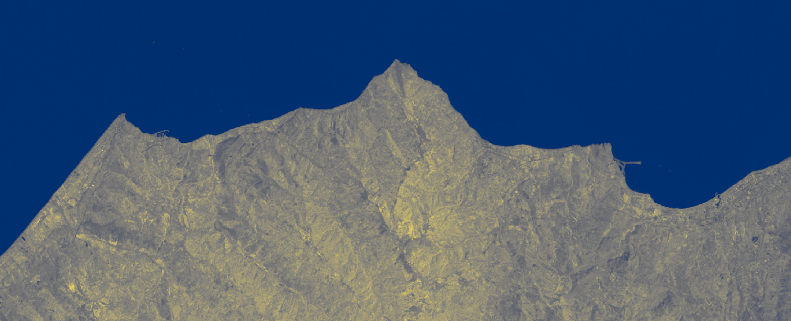




2.4 Action on mapping and modeling for natural hazards and geo-resources
Isoradiometric shoreline extraction tool using multispectral satellite images
Landsat Satellite Product
Scene: 188034
Date: 20200725
U.O. PALERMO 02
Prof. Attilio Sulli
Dr. Francesco Caldareri
Dr. Nicolò Parrino
Prof. Antonino Maltese

Slide 2
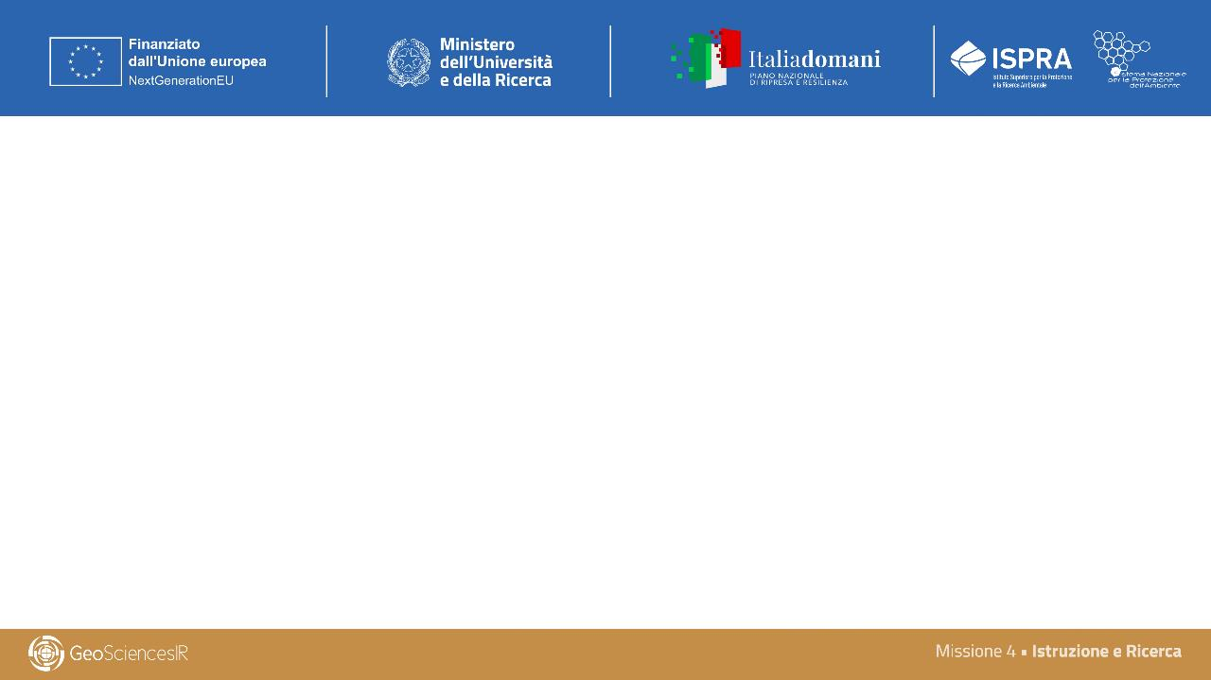
2.4 Action on mapping and modeling for natural hazards and geo-resources
Activity 2.4a - Natural hazards and geological resources in the coastal-marine environment
Developed products:
Geological database in submerged marine areas;
Isoradiometric shoreline extraction tool using multispectral satellite images;
Contribution to the creation of training products.

Slide 3
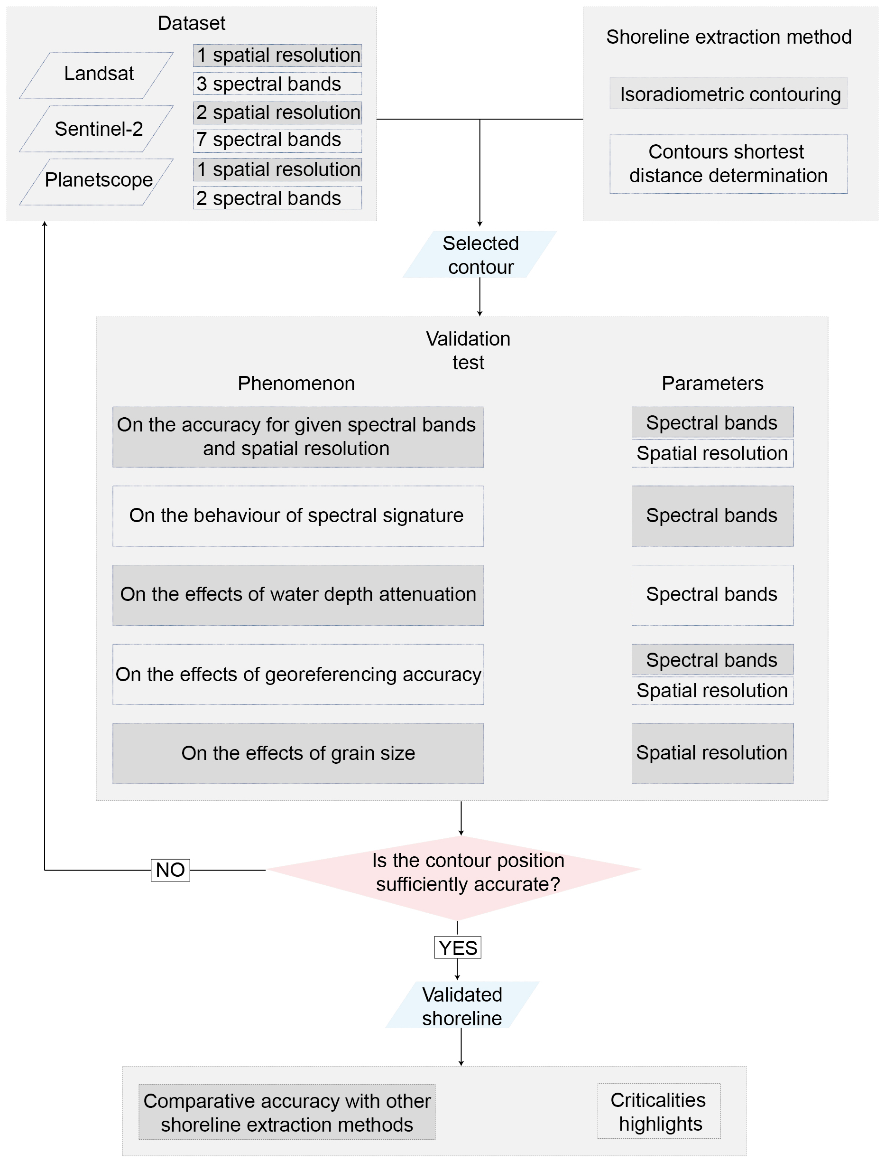


The methodology development
The Isoradiometric Shoreline Extractor
QGIS API
Python
ISE Plugin
Advantages and Applications
The plugin offers several significant advantages over traditional methodologies:
Enhanced sub-pixel accuracy in shoreline delineation
Reduced sensitivity to atmospheric perturbations
Fully automated processing pipeline
Native GIS environment integration
Primary applications encompass:
1. Coastal erosion monitoring
2. Maritime infrastructure impact assessment
3. Coastal dynamics studies
4. Climate change impact analysis on coastal regions
5. Support for coastal zone management and planning

Slide 4
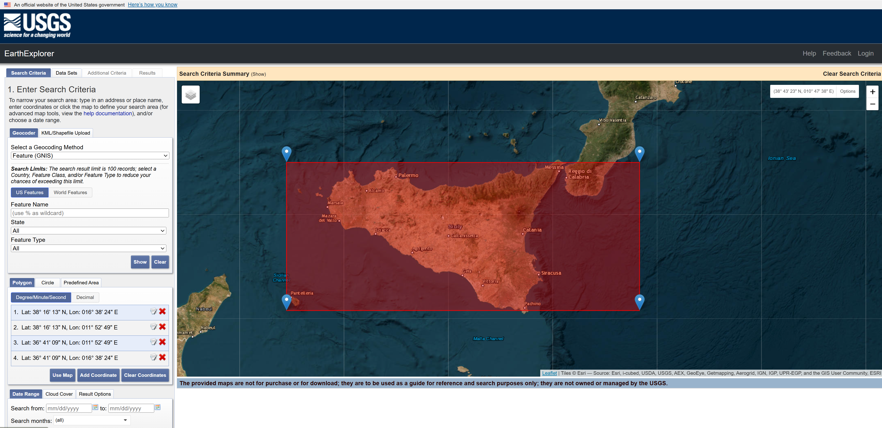
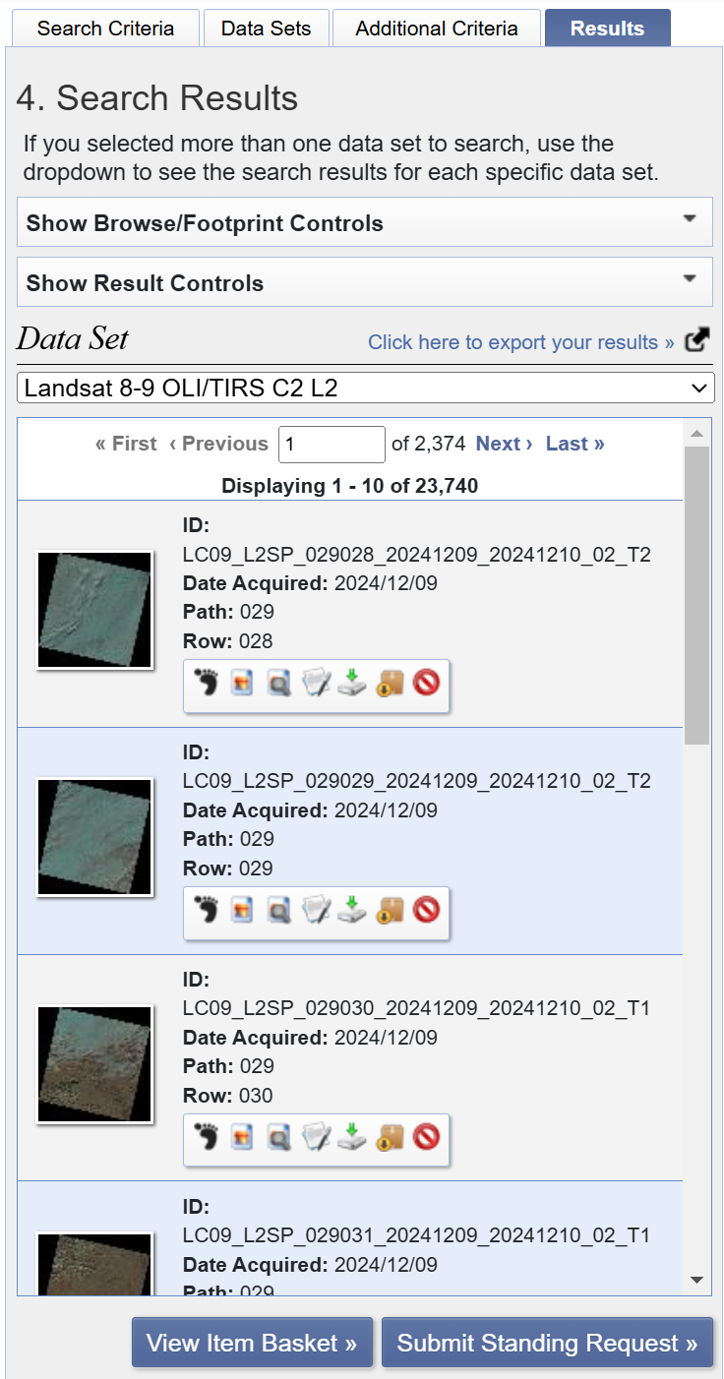
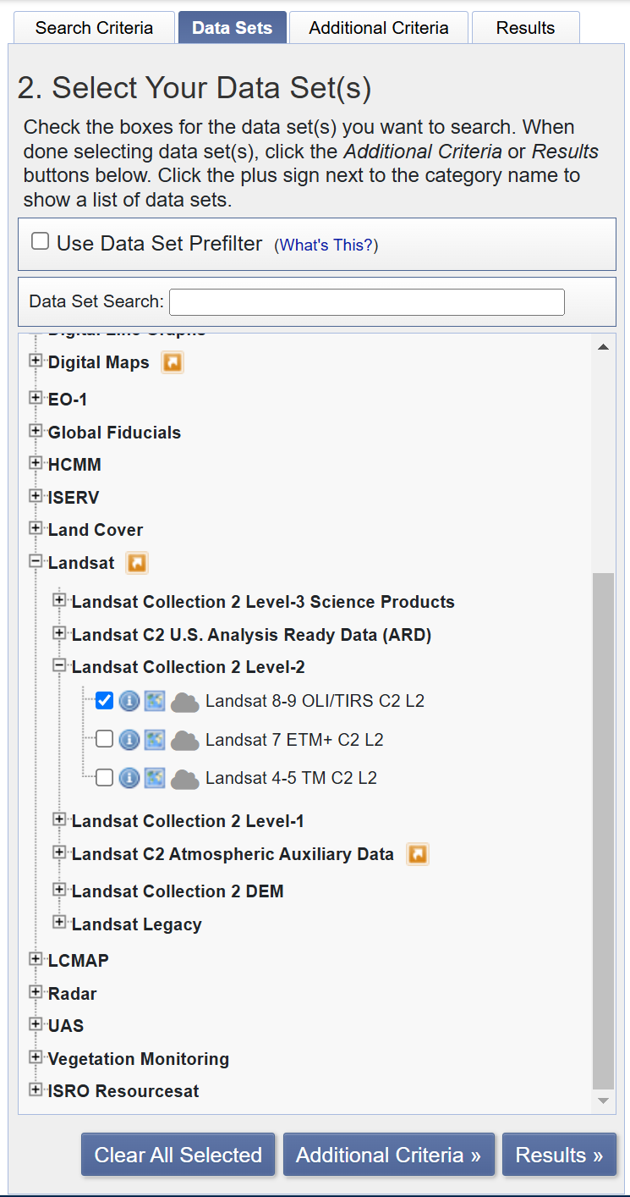
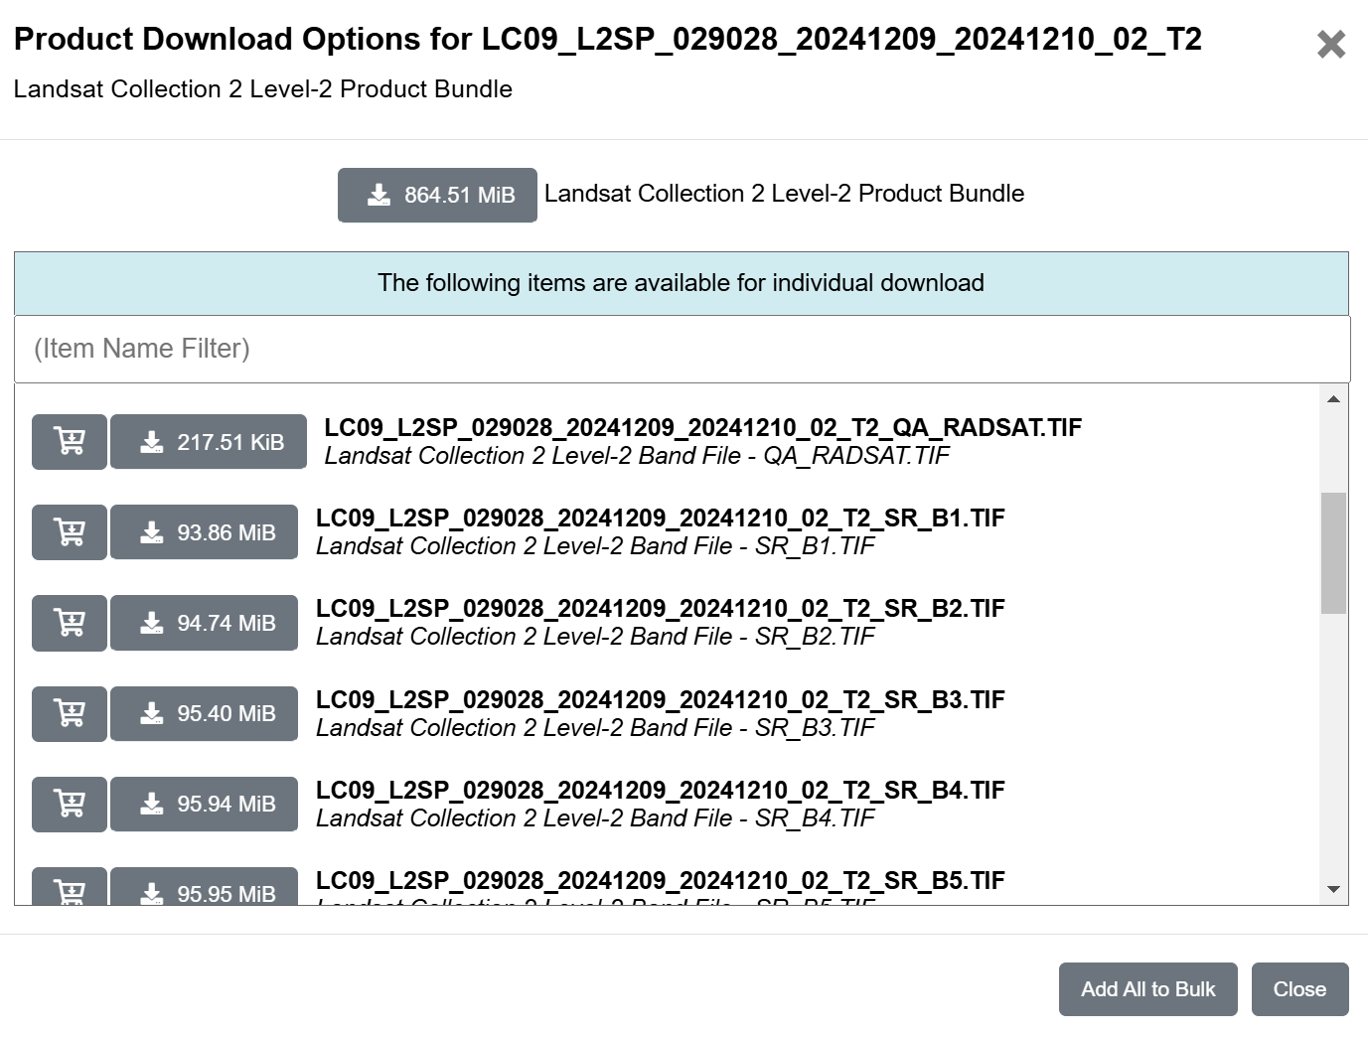
Download Landsat----->https://earthexplorer.usgs.gov/
Create account and login
Search Criteria:
  Select area of interest using map or coordinates
  Select temporal interval and cloud cover percentage
Data Sets:
  Select dataset: Landsat 8-9 OLI/TIRS Collection 2 Level-2
Results:
  Download satellite product (Band 5)
Pay attention:
Polygon RS and Satellite products RS must be the same
NIR is band 4 in Landsat 4-5-7 and band 5 in Landsat 8-9

